Slide 1
Antrian Prioritas
Usage Parameter Control

Slide 2
Shaping increases network efficiency by reducing output bandwidth
With shaping
Re-space the input cells
without shaping

Slide 3
CAC examines whether network resources are sufficient or not for a new
Bit rate
CAC
Necessary bandwidth < Space of bandwidth ?
Time
accept or reject
Already in use

Slide 4
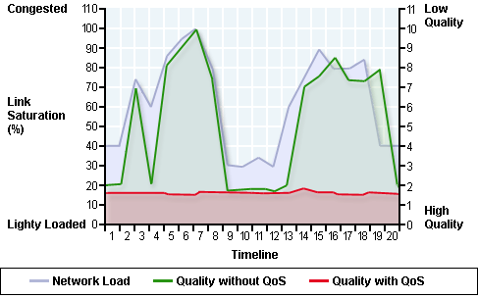

Slide 5
QoS Design
Contoh : Kualitas Voice dalam Jaringan VoIP dipengaruhi langsung oleh dua faktor utama :
Packet loss
Delay Packet
Selain itu, echo tidak langsung indirectly disebabkan kualitas voice pada jaringan VoIP

Slide 6
Packet Loss
There are several reasons for packet loss, including:
1. Congestion caused by queues overflowing their packet limits
2. Network nodes running out of buffer space
3. Memory limitations in network nodes
4. Policing, or controls that watch traffic flows, ensuring that they conform to certain bandwidth levels. If bandwidth levels are exceeded, policing controls will drop all packets exceeding the given rate.
Packet Delay
Packet delay can cause either voice-quality degradation, due to the end-to-end voice latency, or packet loss, if the delay is variable. If the end-to-end voice latency becomes too long (250 msec, for example

Slide 7
Echo
Echo bukan masalah khusus terhadap packet switching tetapi berpengaruh pada teknologi Circuit switching yang disebabkan oleh dua hal :
Level input sinyal (gain)/level sinyal output (attenuation)
Mismatch Impedansi.

Slide 8
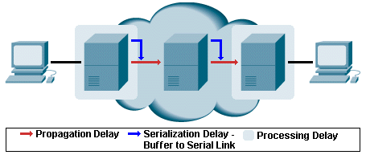
Komponen Fixed Delay
Propagation—six microseconds per kilometer
Serialization
Processing
Coding/compression/decompression/decoding
Packetization

Slide 9
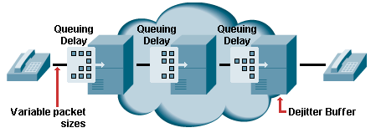
Komponen Variable Delay
Queuing delay
Dejitter buffers
Variable packet sizes

Slide 10
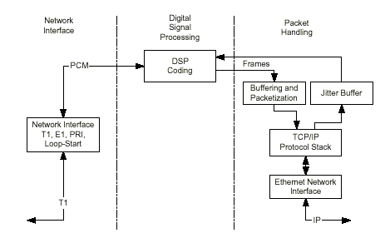
Gateway Processing

Slide 11
Contoh dalam VoIP QoS :
Classification
Queuing
Network provisioning

Slide 12
Queuing’s Premise
Getting better service is a matter of managing congested queues
Over-all latency and bandwidth are constant
Make some traffic absorb latency, and therefore give up bandwidth
Shield other traffic from latency, and therefore gain bandwidth

Slide 13
FIFO Queuing
Premise
“Packets leave in order of arrival”
Fixed queue lengths
Results in dropping from tail of queue under load
Results in flow synchronization

Slide 14
Simplest QoS Algorithm: Priority Queuing
Stated requirement:
“If <application> has traffic waiting, send it next”
Commonly implemented
Defined behaviour of IP precedence

Slide 15
Priority Queuing Implementation Approach
Identify interesting traffic
Access lists
Place traffic in various queues
De queue in order of queue precedence

Slide 16
Priority Queuing (PQ)
Interface Hardware
Ethernet
Frame Relay
ATM
Serial Link
Etc.
High
Traffic Destined for Interface
Medium
Transmit Queue
Output Line
Classify
Normal
Low
Q Length Defined by Q Limit
Absolute Priority Scheduling
Interface Buffer Resources
Classification by:
Protocol (IP, IPX, AppleTalk, SNA, DecNet, Bridge, etc.)
Incoming Interface (EO, SO, S1, etc.)

Slide 17
Priority Queuing
Forwarder
Priority (Access) List
Classification
Low Priority
Medium Priority
High Priority
Transmission Queue

Slide 18
Pitfalls of Priority Queuing
Can cause traffic lockout if not well engineered
FIFO by priority:
Within priority, still unpredictable

Slide 19
Class-Based Queuing
One standard : custom queuing
Stated requirement:
“Traffic with <characteristics> needs a guaranteed rate or latency”
“Characteristics” may be:
Application
Traffic source

Slide 20
Custom Queuing Implementation Approach
Identify the traffic
Distribute into FIFO queue by class
Dequeue in some rotation
Remove some number of bytes at most
Move to next queue in round robin order

Slide 21
Interface Hardware
Ethernet
Frame Relay
ATM
Serial Link
Etc.
1/10
Traffic Destined for Interface
2/10
3/10
Transmit Queue
Output Line
Classify
2/10
3/10
Up to 16
Link Utilization Ratio
Weighted Round Robin Scheduling
(byte count)
Q Length Deferred by Queue Limit
Classification by:
Protocol (IP, IPX, AppleTalk, SNA, DecNet, Bridge, etc.)
Incoming interface (EO, SO, S1, etc.)
Interface Buffer Resources
Allocate Proportion of Link Bandwidth)

Slide 22
Custom Queuing
Forwarder
Priority (Access) List
Control Traffic
Queue #0
Queue #1
Queue #9
Queue #2
Queue #10
Queue #3
Queue #11
Queue #4
Queue #12
Queue #5
Queue #13
Queue #6
Queue #14
Queue #7
Queue #15
Queue #8
Queue #16
Transmission Queue

Slide 23
Pitfalls of Custom Queuing
FIFO by class:
Within class, still unpredictable

Slide 24
Weighted Fair Queuing (WFQ)
Stated requirement:
“Traffic latency must be predictable”
“Reserved flows must achieve a certain bandwidth and latency”

Slide 25
Fair Queuing Approach
Enqueue traffic in the sequence the TDM would deliver it
As a result, be as fair as the TDM

Slide 26
Effects of Fair Queuing
Low-bandwidth flows get
As much bandwidth as they can use
Timely service
High-bandwidth flows
Interleave traffic
Cooperatively share bandwidth
Absorb latency

Slide 27
What Weighting Does
In TDM
Channel speed determines message “duration”
In WFQ
Multiplier on message length changes simulated message “duration”
Result:
Flow’s “fair” share predictably unfair

Slide 28
Weighted Fair Queuing (WFQ)
Traffic Destined for Interface
Transmit Queue
Output Line
Classify
Weighted Fair Scheduling
Configurable Number of Queues
Flow-Based Classification by:
Source and destination address
Protocol
Session identifier (port/socket)
Interface Buffer Resources
Weight Determined by:
Requested QoS (IP Procedure, RSVP)
Frame Relay FECN, BECN, DE (For FR Traffic)
Flow throughput (weighted-fair)

Slide 29
end

